Slide 1
Analysis of NYPD Complaint Data Using Machine Learning Techniques
ADTA 5340
Professor: Tony Fantasia

Slide 2
Team Brainy Bots
Tejamanikanta Gudla Sai Preethi Jiddigam
Harish Chinnakadiri Indusree Terala
Sai Swetha Puli

Slide 3
TABLE OF CONTENTS
Introduction
How AI and ML Impacts
Business Understanding
Problems to Solve
Dataset Explanation
Data Preparation
EDA
Algorithms Used
Algorithm Comparison
Model Predictions
Future Suggestions
References

Slide 4

Introduction
New York Police Department use the Complaint records for seeking insights to increase patroling to where the crime rates are gradually high based on time frames, Boroughs and Location axes of the map. New York being the most visited city in America by tourists, more than 95% of the resident's commute for work daily. Being the liveliest place, the crime rate of New York city should be taken into consideration to oversee the public safety.

Slide 5
How AI and ML Impacts
Many of the Departments PredPol type of tools to predict crime suspecting locations. Facial Recognition sensors in surveillances helps in two ways. Many algorithms used to find patterns in the crime based on the offensive description and the crime identification.

Slide 6
Business Understanding
1. Operational Efficiency:
Patrol Management
Emergency Response
2. Public Safety and Trust:
Enhanced Public Confidence
Community Relations

Slide 7

Problems to Solve
This data covers the crime recorded complaints data in New York region. The problem can be defined as how to use this data to better predict crime locations based on complaints.

Slide 8
Dataset
NYPD Crime complaint records

Slide 9
Data Explanation
In this Dataset we have Unique complaint number and details of incident recorded data and time. These categorizes into crime codes by KY_CD and PD_CD with OFNS_DESC and PD_DESC and the status of the complaint with law category and location latitude and longitudes. It had 361740 records and 24 columns in the raw dataset.

Slide 10
Data Preparation
This steps follows the removal of columns with count above the - 50% missing values as well as all rows containing missing values in any cell to maintain data accuracy. Moreover, non-numeric data columns like the created date and time for each complaint listing were also removed due to redundancy.

Slide 11
Exploratory Data Analysis
Bar chart
Pie Chart
Stacked bar chart
Complaints based on Borough Names
Offensive description
Outcome of the law Category

Slide 12
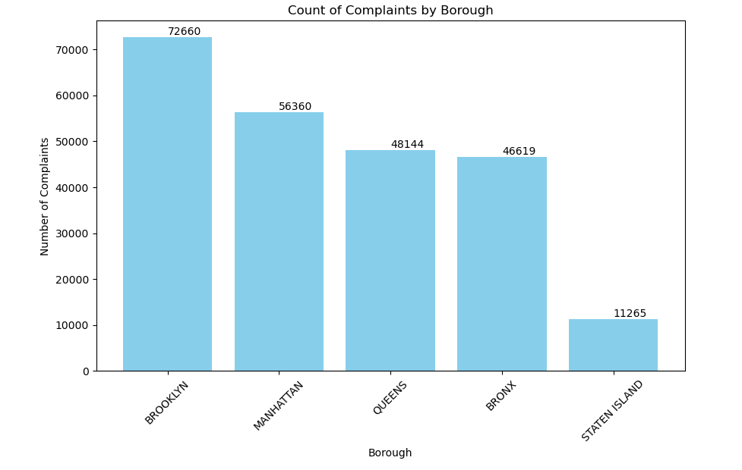
Plots

Slide 13
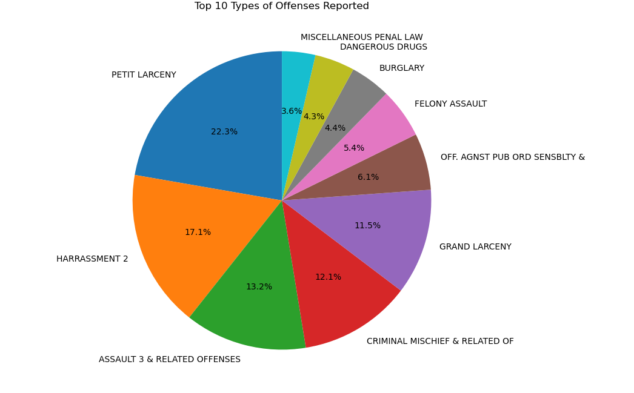
Plots

Slide 14
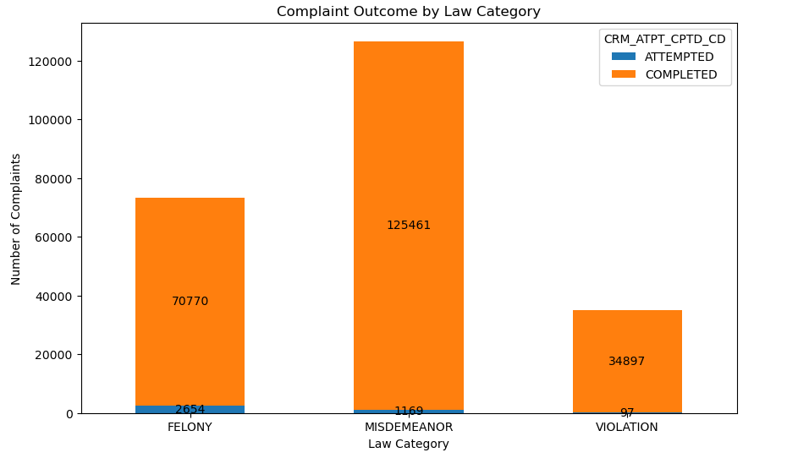
Plots

Slide 15

Data Encoding & validation,
In our data we have many categorical columns. So, we have used label encoding to manage the data columns. We have used K fold cross validation in the code for better results on training and testing data splits.

Slide 16
Algorithms Used
Logistic regression
Decision tree classification
Random forest classiification
Random forest regression

Slide 17

Algorithm Comparison
After using all the models, we are finalizing the model by the score produced by each model.

Slide 18
Model Prediction
We are calculating the scores for each model taken in the process

Slide 19

Future Suggestions

Slide 20
References
NYC Crime Data - dataset by data-society. (2024, April 15). data.world. https://data.world/data-society/nyc-crime-data
NYPD Announces the Publication of its 2023 Strategic Plan. (2023, January 25). The Official Website of the City of New York. https://www.nyc.gov/site/nypd/news/p00072/nypd-the-publication-its-2023-strategic-plan

Slide 21
Thank You

